Slide 1
A Latent Semantic Model with Convolution-Pooling Structure for Information Retrieval
Microsoft Research
Yelong Shen, Xiaodong He, Jianfeng Gao, Li Deng, Gregoire Mesnil

Slide 2
Motivation
Problems
microsoft office excel could allow remote code execution
welcome to the apartment office
online body fat percentage calculator
online auto body repair estimates
Contextual information
Modeling Term Dependencies for IR
N-gram
Latent Semantic Models
PLSA LDA
Neural-Network-based Semantic Models
DSSM

Slide 3
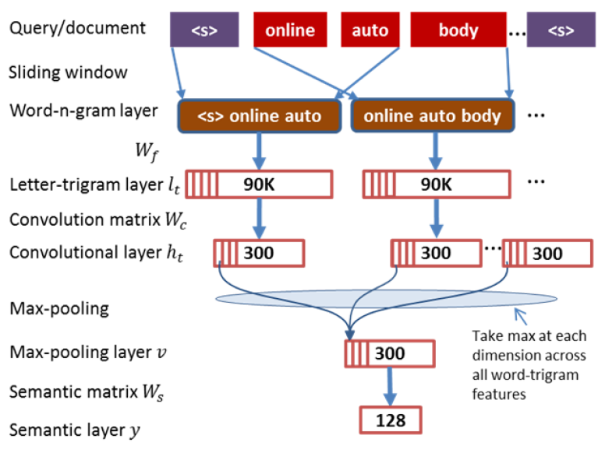
The CLSM Architecture

Slide 4
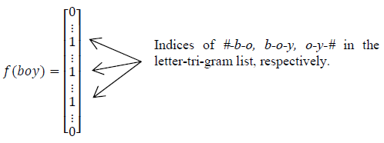
Letter-trigram
A letter-trigram of word “boy” :
About 30K unique letter-trigrams
In letter-trigram layer has a dimensionality of n x 30K

Slide 5


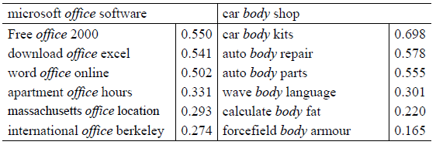
Convolutional Layer
W_{c} is a (n x 30K) x K Convolutional Matrix
All word-n-gram share the weight of W_{c} .

Slide 6

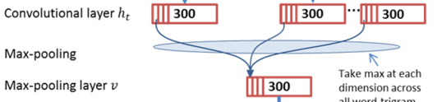
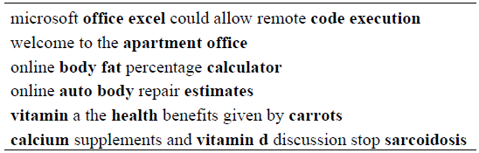
Max Pooling
Aggregate to obtain a sentence-level feature

Slide 7


How to Training?
Loss function
D: document D⁺: positive D⁻: sample J negative
Train on training set, training parameter optimized on the validation set.

Slide 8

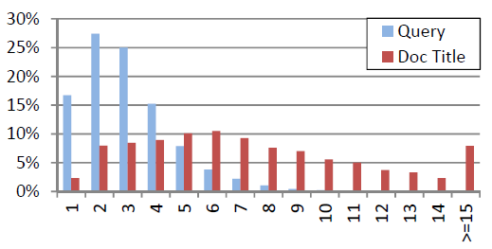
Experiments
Data set : Clickthrough data
Document use Title, not Body.
Query average len 3.01; Title average len 7.78

Slide 9
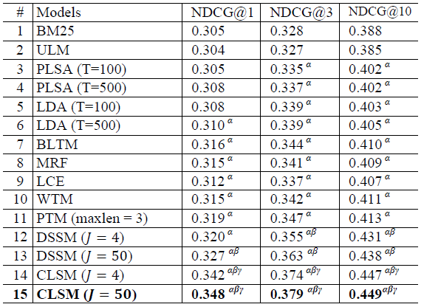
Experiments

Slide 10
Thanks!
Q & A

